Slide 1
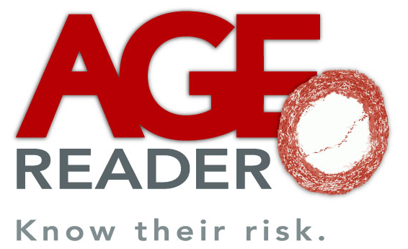
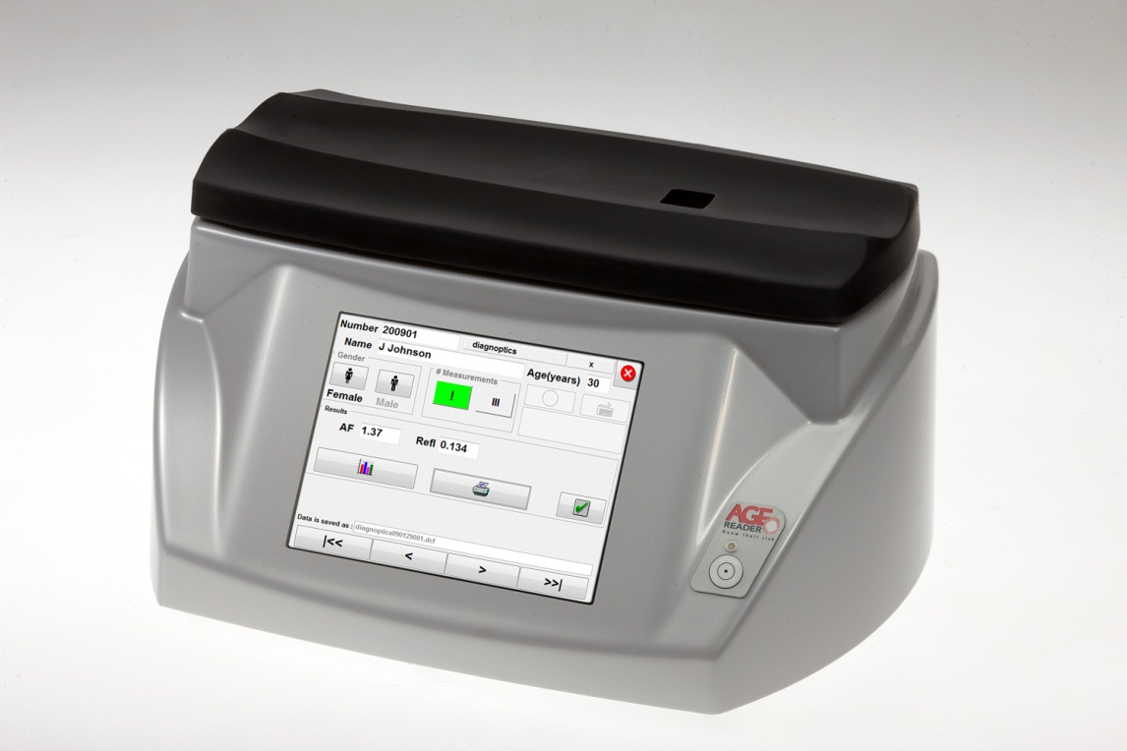
AGE Reader
Non-invasive assessment of cardiovascular risk

Slide 2
Introduction
Cardiovascular risk
Measuring CV risk
AGE Reader
Clinical validation

Slide 3
Cardiovascular risk
70% of diabetics will die of CV event
5 out of 7 drugs (type 2 diabetic)
Events are costly
Difficult to assess
Notes:
The assessment of cardiovascular risk is very important in healthcare. Especially in the case of diabetic patients.
Diabetes is nowadays seen more as a cardiovascular disease than as a glucose/insulin based disease. 70% of the diabetic patients will die because of a cardiovascular event. For that reason doctors focus on the risk that their patient will develop a microvascular or macrovascular complication. As an effect of that, 5 out of the 7 drugs that a typical type 2 diabetic takes, aim at their CV risk. Another reason to assess CV risk, is the fact that they are very costly; both in terms of finance as well as in terms of burden for the patient. A major hurdle in this, is the fact that the actual CV risk of an individual patient is very difficult to assess. The medical society is constantly looking for ways to easily asses CV risk in a more reliable way than the available blood pressure and lipid profiles.

Slide 4
Measuring CV risk
Now in the clinic:
  Risk scores (UKPDS, SCORE, Framingham)
  Intima-media thickness
  Coronary calcification (CT scan)
The AGE Reader gives
  quickly and non-invasively
  reliable extra information to help the physician to improve therapy
Notes:
What options does a doctor have?
Besides blood pressure and lipids, they should use so called risk scores, in the case of diabetes the UKPDS risk score. This is a software application that combines 10 parameters and gives the risk that a patient will die because of a cardiovascular vent within 10 years. This risk score is currently in the medical guidelines in the Western world for the treatment of diabetic patients. In reality is barely used because the reliability is not good enough and you need lab results, which makes that you do not have an immediate feedback to the patient.
In some hospitals doctors use an ultrasound scan of the vascular wall of the bloodvessel going to the brain to assess CV risk. Alternatively, they may do a CT scan to measure the calcification of the heart. Because both technologies are expensive, take a lot of time, are a burden to the patient and there is no reimbursement, there is not a widespread use of these measurements.
As an alternative the AGE Reader offers an immediate measurement result within 30 seconds to help the doctor to optimize his therapy. Moreover it is non-invasive and easy to perform.

Slide 5
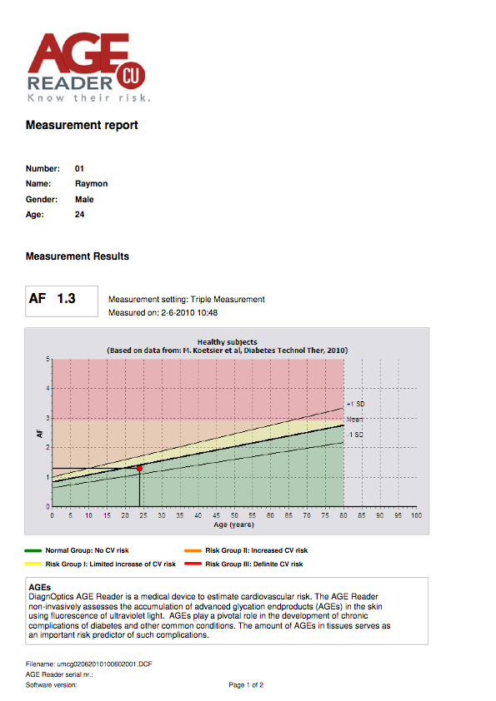
AGE Reader
Measurement report
Notes:
The AGE Reader measurement report gives a clear interpretation of the relative cardiovascular risk of the patient. The measurement (red dot) is placed in a diagram against age (on the horizontal axes). The middle line indicates the normal value for healthy controls. The other two lines are 1 standard deviation above and below this line. Any value below the middle line, indicates that there is no increased cardiovascular risk measured. Above this line, there are 3 risk zones, the red zone indicates for example that there is a definite cardiovascular risk for this patient. On the back side of the measurement report, the interpretation guidelines are given for each of the zones.

Slide 6
Breakthrough publication
Two important conclusions:
  AGE measurement is best single predictor of (CV) mortality (after age)
  When compared with whole risk engine:
    independent
    27% re-classification
© Copyright 2012, DiagnOptics Technologies B.V.
Notes:
The AGE Reader technology has been validated around the world. Originally developed and still manufactured in the Netherlands, to date we count over 65 peer reviewed publications from around the world about clinical studies using the AGE Reader. These studies have included close to 100,000 individuals.
The most important study involved close to 1,000 type 2 diabetic patients who were followed for 5 years. At inclusion both the UKPDS risk score and the AGE Reader value were measured to assess the CV risk. The UKPDS risk score includes blood pressure, lipid profile, diabetes duration, age, gender, smoking habits, HbA1c, and others. 5 years later the actual clinical development of these patients was assessed. The result is striking. When the AGE Reader value is compared to all 10 parameters of the UKPDS risk score, the AGE Reader value was the BEST single predictor of cardiovascular and total mortality after age. And when compared to the total UKPDS risk score, the AGE Reader value was still independent and lead to re-classification of 27% of the patients in the middle risk group to the high risk group, and vice versa. This means that when a doctor uses the UKPDS they miss a considerable part of the high risk patients and they overtreat a similar part of the patients that turned out to NOT have a high CV risk. In the end the conclusion is that the predictive value of the AGE Reader value is similar to that of the UKPDS risk score.
Important is to remember that the AGE Reader is not a combination of 10 different parameters, of which a part is the result of a lab analysis. The AGE Reader measurement is non-invasive, easy to perform, and takes no longer than 30 seconds.

Slide 7
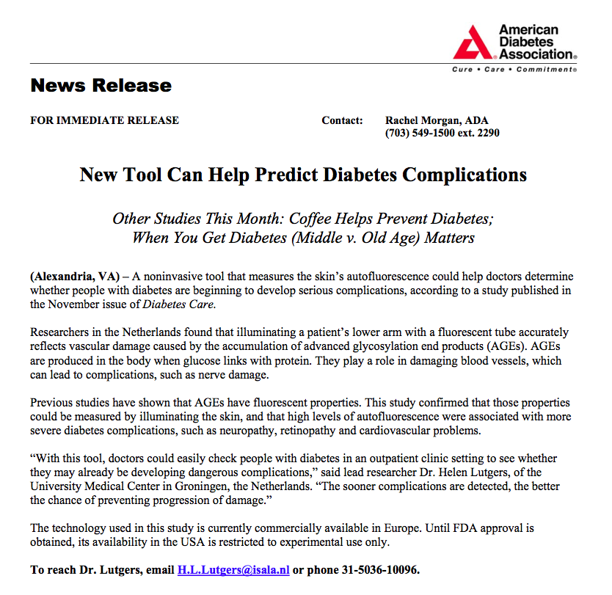
© Copyright 2012, DiagnOptics Technologies B.V.
Notes:
As a result of one of the scientific AGE Reader publications in Diabetes Care, the American Diabetes Association sent out a press release about the potential value of the AGE Reader for diabetes care.

Slide 8
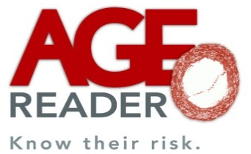
Case Report 1
AGE Reader and CV risk in clinical practice

Slide 9
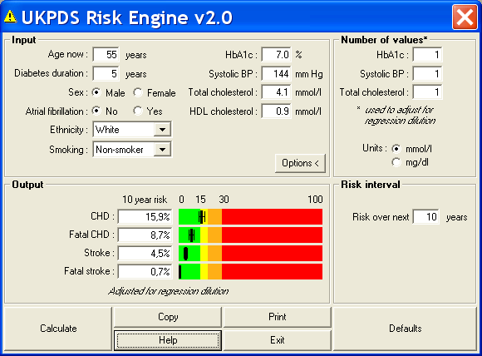
Case Report
Ideal doctor:
“when do I need to intensify treatment?”
Risk often in ‘grey’ zone

Slide 10
Ideal doctor knows: guidelines tell me to weigh other risk factors, but .....
Metabolic syndrome, CRP, homocysteine: only marginal additive (to UKPDS RE) improvement in prediction of CV events
Micoralbuminuria, renal dysfunction, hsCRP: require repeated sampling because of variability, medication, intermittent disease etc.
IMT or coronary calcification score not generally available, expensive, radiation exposure. Still > 4-fold increase coronary CT in US over last decade (NEJM 2009)

Slide 11
Consequences of current guidelines in daily clinical practice
Clinicians aware of weaknesses of risk scores
Use UKPDS RS requires all 10 items and risk score result to be available at moment of patient visit to make decisions. In practice not so easy …
Therefore, risk engines not used at all in majority!
Similar situation for use of additional RF
Then: to be on the safe side, doctor decides to intensify treatment

Slide 12
Case Report 2
CV risk in clinical practice
+
AGE Reader measurement

Slide 13
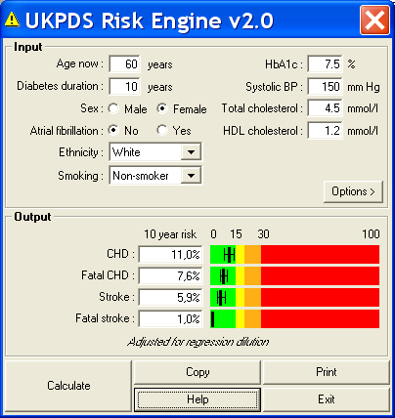
Clinical practice
AGE Reader in clinical practive
AF value = 3.6.
Additive info with AGE reader:
If AF =3.6 → median life expectancy this patient 25/2.62 = 9.5 yr
If the same patient has an AF = 2.4, → Median life expectancy 14.4 yr

Slide 14
Extension to T1DM
Chabroux et al. (2010):
French study in Lyon region in T1DM
Confirms associations between AGE reader levels and nephropathy and neuropathy complications

Slide 15
Added proof in T2DM;
AURORA study:
Cross-sectional study in 566 T2DM patients controlled in 5 Dutch hospitals: sicker, higher HbA1c, more comorbidity
Relation SAF with complications similar to previous study in primary care, better controlled patients
SAF adds again to UKPDS!
Independent contribution SAF to UKPDS RS for existing CVD
Noordzij, EASD 2011;subm. Diabetes care

Slide 16
Renal failure
CV complications and mortality in renal failure:
In dialysis patients: 2 new, Japanese and Dutch , cohorts. Now studies available in 3 different cohorts on predictive value in hemodialysis patients
More importantly: association SAF with CV complications extends also to CKD 3 (GFR 30-60 ml/min)(McIntyre, RRID; CJASN 2011):
Therapeutic implications more important in this group !

Slide 17
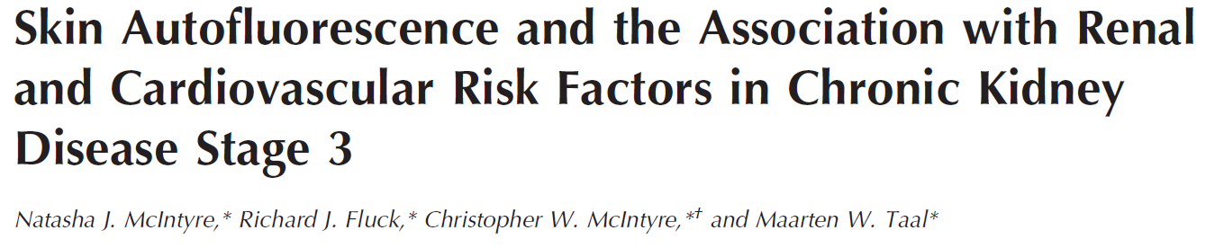
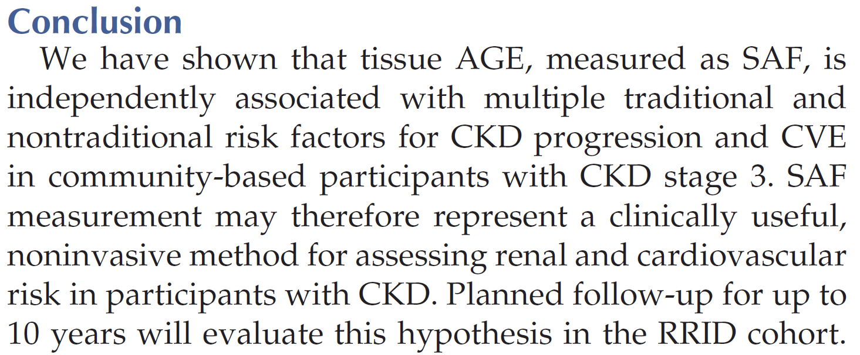

Slide 18
USPs AGE Reader
Clinically proven
Non-invasive
Reproducibility
No consumables
Quick
Easy to perform
Very few competitors

Slide 19
Thank you for your attention

