Slide 1
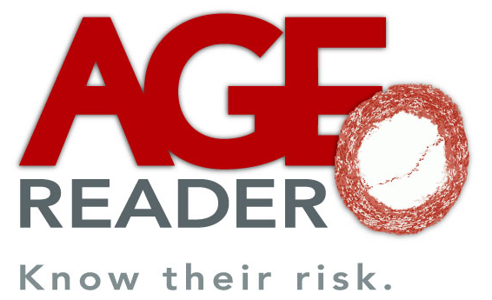
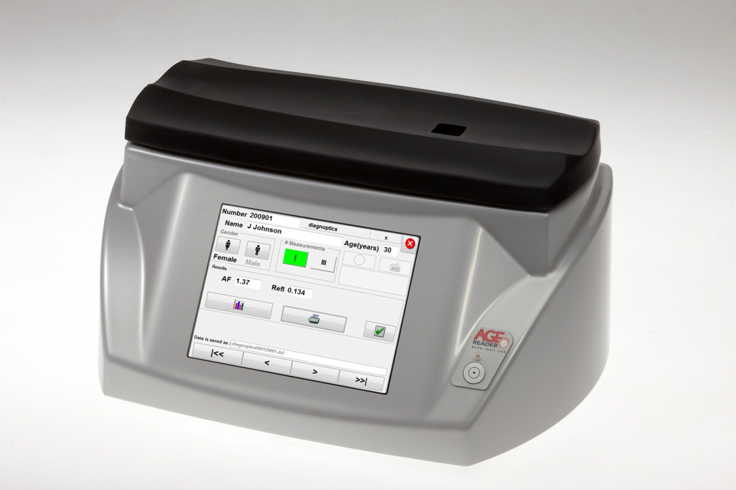
AGE Reader
Non-invasive assessment of cardiovascular risk

Slide 2
Introduction
Cardiovascular risk
Measuring CV risk
AGE Reader
Clinical validation

Slide 3
Cardiovascular risk
70% of diabetics will die of CV event
5 out of 7 drugs (type 2 diabetic)
Events are costly
Difficult to assess
Notes:
The assessment of cardiovascular risk is very important in healthcare. Especially in the case of diabetic patients.
Diabetes is nowadays seen more as a cardiovascular disease than as a glucose/insulin based disease. 70% of the diabetic patients will die because of a cardiovascular event. For that reason doctors focus on the risk that their patient will develop a microvascular or macrovascular complication. As an effect of that, 5 out of the 7 drugs that a typical type 2 diabetic takes, aim at their CV risk. Another reason to assess CV risk, is the fact that they are very costly; both in terms of finance as well as in terms of burden for the patient. A major hurdle in this, is the fact that the actual CV risk of an individual patient is very difficult to assess. The medical society is constantly looking for ways to easily asses CV risk in a more reliable way than the available blood pressure and lipid profiles.

Slide 4
Measuring CV risk
Now in the clinic:
  Risk scores (UKPDS, SCORE, Framingham)
  Intima-media thickness
  Coronary calcification (CT scan)
The AGE Reader gives
  quickly and non-invasively
  reliable extra information to help the physician to improve therapy
Notes:
What options does a doctor have?
Besides blood pressure and lipids, they should use so called risk scores, in the case of diabetes the UKPDS risk score. This is a software application that combines 10 parameters and gives the risk that a patient will die because of a cardiovascular vent within 10 years. This risk score is currently in the medical guidelines in the Western world for the treatment of diabetic patients. In reality is barely used because the reliability is not good enough and you need lab results, which makes that you do not have an immediate feedback to the patient.
In some hospitals doctors use an ultrasound scan of the vascular wall of the bloodvessel going to the brain to assess CV risk. Alternatively, they may do a CT scan to measure the calcification of the heart. Because both technologies are expensive, take a lot of time, are a burden to the patient and there is no reimbursement, there is not a widespread use of these measurements.
As an alternative the AGE Reader offers an immediate measurement result within 30 seconds to help the doctor to optimize his therapy. Moreover it is non-invasive and easy to perform.

Slide 5
AGEs
Advanced Glycation Endproducts
  Glycated proteins
AGE values rise in everyone when getting older.
  But, much quicker in diabetes
AGEs play a central role in the development of diabetes and cardiovascular risk.
Notes:
Advanced Glycation Endproducts are the endproducts of a chemical reaction that takes place in everybody. In this so-called Maillard- or browning reaction, glucose reacts with proteins. HbA1c is one of the intermediate products of this reaction. The AGEs are irreversible and will stay in the human tissue for as long as the proteins that they are cross-linked to, will. Becasue of that they have a lifetime of over 10 years. This makes that AGEs accumulate during life, and thus your AGE value rises. Because diabetics have more glucose available, they accumulate AGEs quicker than non-diabetics.
Importantly AGEs play a centrol role in the development od diabetes and its cardiovascular complications. That is also the reason that at least 10 pharmaceutical companies are currently developing new drugs to decrease AGE levels.

Slide 6
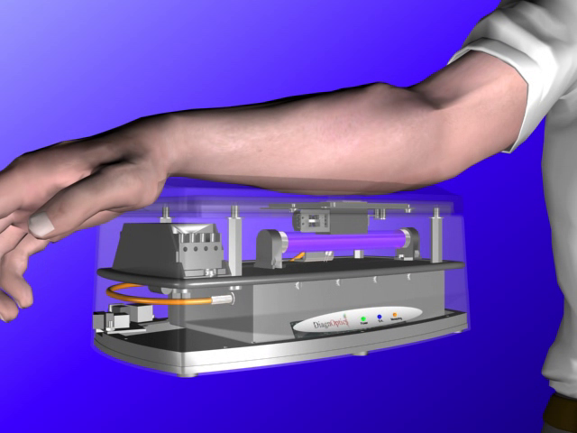

AGE Reader
Notes:
A major part of the AGEs in tissue is fluorescent. The AGE Reader uses this fluorescence by shining safe UV-a light into the skin of the forearm. The AGEs present in the skin will send fluorescent light and the AGE Reader measures the amount of a specific part of this light. It immediately gives a result of this 30 seconds measurement.

Slide 7
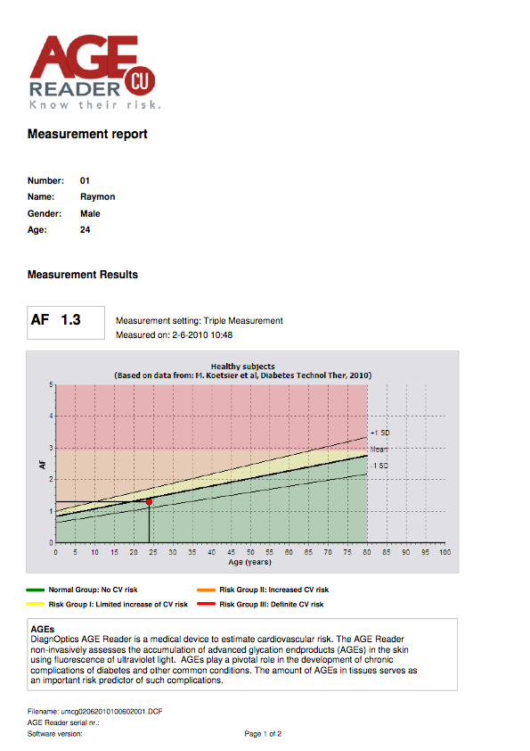
AGE Reader
Measurement report
Notes:
The AGE Reader measurement report gives a clear interpretation of the relative cardiovascular risk of the patient. The measurement (red dot) is placed in a diagram against age (on the horizontal axes). The middle line indicates the normal value for healthy controls. The other two lines are 1 standard deviation above and below this line. Any value below the middle line, indicates that there is no increased cardiovascular risk measured. Above this line, there are 3 risk zones, the red zone indicates for example that there is a definite cardiovascular risk for this patient. On the back side of the measurement report, the interpretation guidelines are given for each of the zones.

Slide 8
Breakthrough publication
Two important conclusions:
  AGE measurement is best single predictor of (CV) mortality (after age)
  When compared with whole risk engine:
    independent
    27% re-classification
© Copyright 2012, DiagnOptics Technologies B.V.
Notes:
The AGE Reader technology has been validated around the world. Originally developed and still manufactured in the Netherlands, to date we count over 65 peer reviewed publications from around the world about clinical studies using the AGE Reader. These studies have included close to 100,000 individuals.
The most important study involved close to 1,000 type 2 diabetic patients who were followed for 5 years. At inclusion both the UKPDS risk score and the AGE Reader value were measured to assess the CV risk. The UKPDS risk score includes blood pressure, lipid profile, diabetes duration, age, gender, smoking habits, HbA1c, and others. 5 years later the actual clinical development of these patients was assessed. The result is striking. When the AGE Reader value is compared to all 10 parameters of the UKPDS risk score, the AGE Reader value was the BEST single predictor of cardiovascular and total mortality after age. And when compared to the total UKPDS risk score, the AGE Reader value was still independent and lead to re-classification of 27% of the patients in the middle risk group to the high risk group, and vice versa. This means that when a doctor uses the UKPDS they miss a considerable part of the high risk patients and they overtreat a similar part of the patients that turned out to NOT have a high CV risk. In the end the conclusion is that the predictive value of the AGE Reader value is similar to that of the UKPDS risk score.
Important is to remember that the AGE Reader is not a combination of 10 different parameters, of which a part is the result of a lab analysis. The AGE Reader measurement is non-invasive, easy to perform, and takes no longer than 30 seconds.

Slide 9
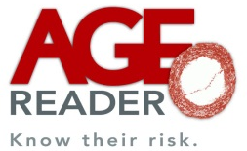
Additive predictive value skin AF on top of UKPDS risk score in type 2 diabetes (n=967)
Group 1. Both AF and UKPDS score < median
Group 2. AF > median and UKPDS score < median
Group 3. AF < median and UKPDS > median
Group 4. Both AF and UKPDS score > median
Event-free survival
(mortality + CV-morbidity)
Lutgers, Diabetol 2009

Slide 10
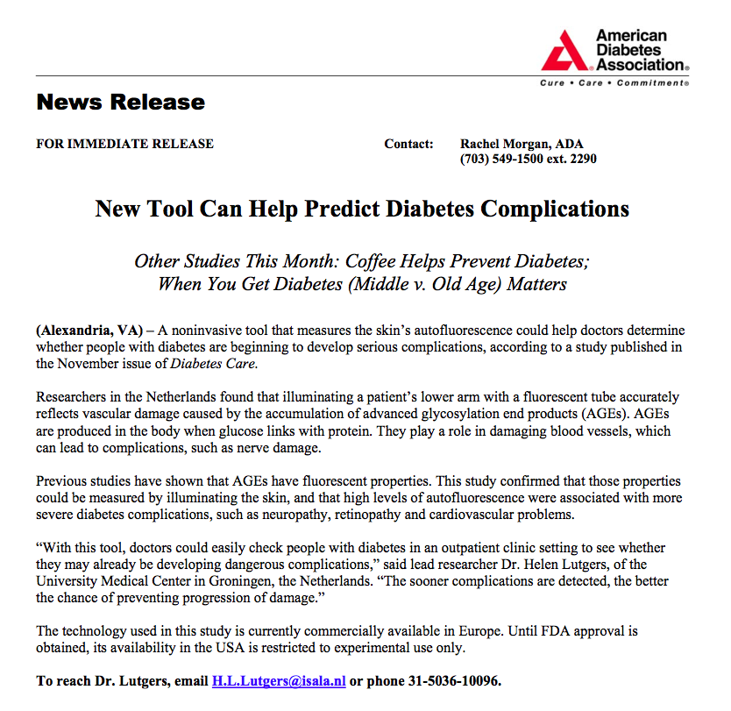
© Copyright 2012, DiagnOptics Technologies B.V.

Slide 11

USPs AGE Reader
Clinically proven
Non-invasive
Reproducible
No consumables
Quick
Easy to perform

Slide 12
Thank you for your attention

